Slide 1


Step-by-Step Guide to Register for Classes at Gov State

Slide 2
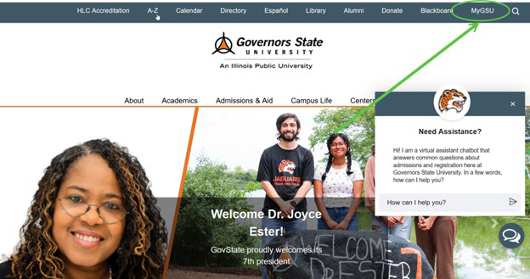
Step 1: Access the Gov State Website
Go to the Governors State University website (https://www.govst.edu) and select the MyGSU tab.

Slide 3
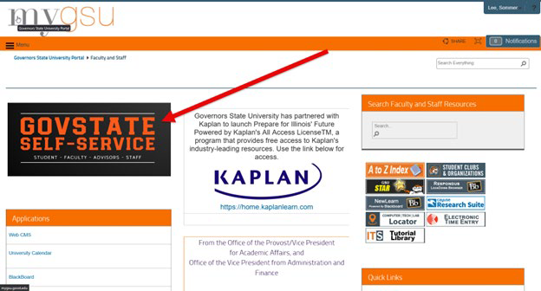
Step 1: Continued
Locate and click on the black "Self-Service" box on the homepage.

Slide 4
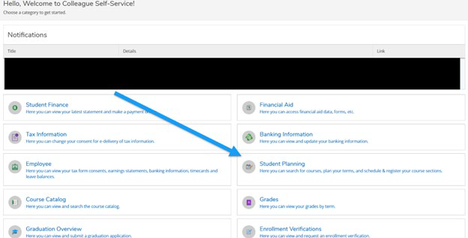
Step 2: Navigate to Student Planning
In the Self-Service portal, select “Student Planning.”

Slide 5
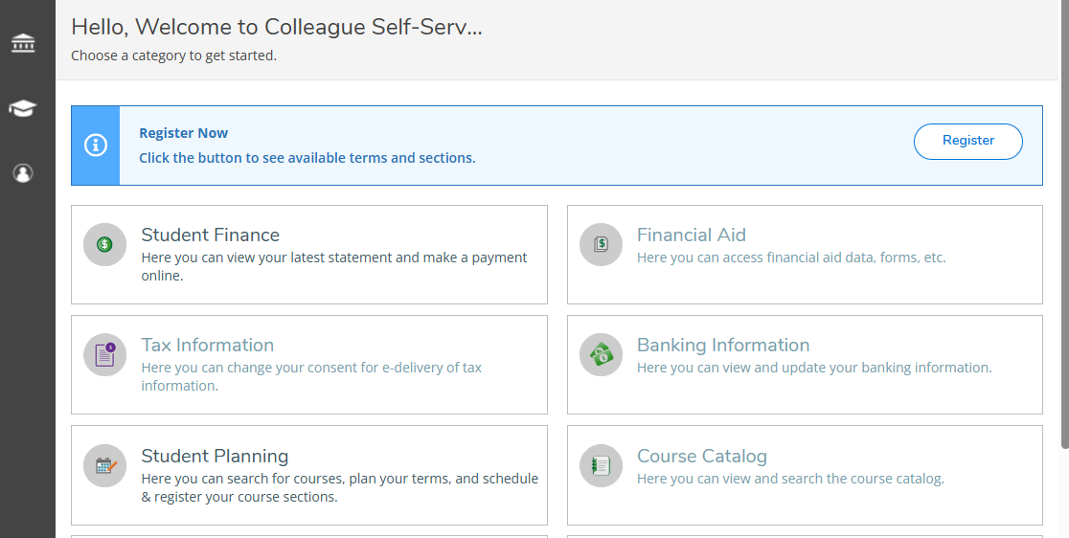
Step 2: Continued
Student Portal Update
You can now register for previously planned courses from the self-service portal page.

Slide 6
Step 3: View Your Progress
Click on "Step 1: View Progress."
Review your degree progress.
Look for red highlighted categories-these indicate courses you still need.

Slide 7
Step 3: Continued
Click "Show Details" under each red category to expand course options.
A search box will appear within the selected category.

Slide 8
Step 4: Search for Courses
Use the filters on the left-hand side:
Check "Open Sections Only."
Select the term you want to register for (e.g., Fall, Spring, Summer).
Find the course you're interested in.
Click the grey "View Available Sections" box under the course title.

Slide 9
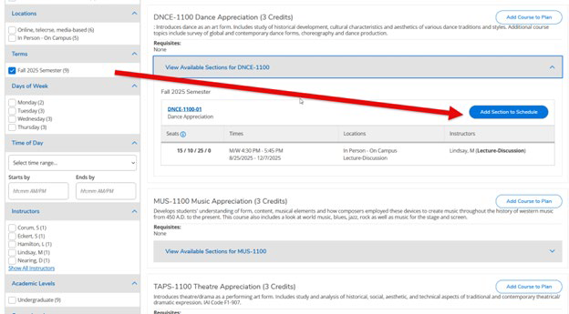
Step 5: Add Courses to Your Schedule
Browse the available sections.
Click the blue "Add Section to Schedule" button for the section that fits your schedule.
*Note: Some courses may only have one section available. *

Slide 10
Step 5: continued
Courses added to your plan will appear in yellow, indicating they are planned but not registered.

Slide 11
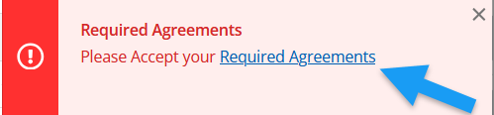
Step 6: Register for Classes
Return to the Student Planning page.
Select "Plan Your Degree & Register for Classes."
A red popup notification will appear in the top-right corner.
Click it to acknowledge and agree to the required agreements.

Slide 12

Step 6: Continued
After agreeing, go back to the "Plan Your Degree & Register for Classes" page.
Click the blue "Register Now" button.
If the button is greyed out, you likely haven't completed the agreement step.

Slide 13
Step 7: Confirm Your Registration
Check your schedule.
If your courses have changed from yellow to green, you are successfully registered.

